Slide 1


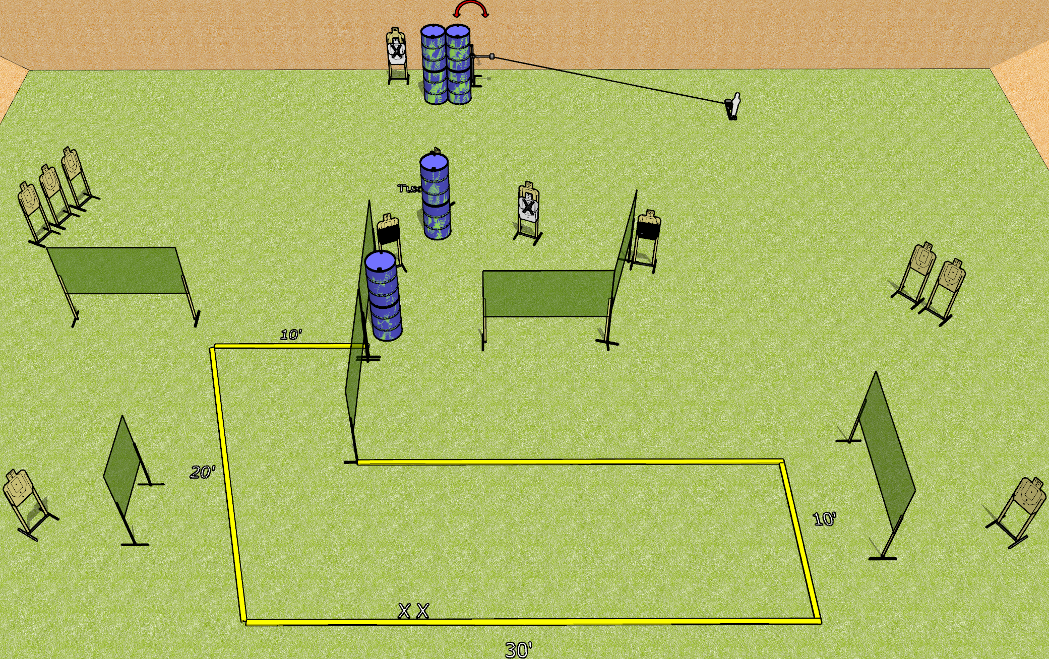
 | Dothan Gun Club – USPSA Match Strong Shift Course Designer : Drew Coleman
Round Count 27 rounds 13 USPSA 1 mini popper
Equipment List 1 swinger + activator 13 wall feet 2 50%, 1 Tuxedo

Slide 2
Strong Shift
Written Stage Briefing
Strong shift is a 27 round, 135 point, Comstock course of fire. There are 13 USPSA targets and 1 mini popper. The best 2 hits on paper will score, and steel must fall to score. The start signal is audible.
The swinger is activated by the mini popper and remains visible at rest.
Handgun start position is both feet on X’s, wrists below belt. Handgun is loaded and holstered.
PCC start position is both feet on X’s, stock on belt. Loaded carbine is held with both hands, safety on.
On start signal engage targets as they become available from within the shooting area.

